Slide 1
Journey PPT
Sitesh Muduli (SH7B23231)

Slide 2
Technical Skills (Day 1)
Understanding business analysis and project management techniques from a technical view.
Understanding agile and scrum practices.
Software Development Life Cycle.
Understanding waterfall and agile model and understanding their pitfalls.

Slide 3
Understanding some concepts of devops.

Slide 4
Day 2
Creating an account in azure devops.
Understanding implementing scrum concepts such as product backlog and scrum sprints using some boiler plate project.
Getting familiarized with board and task view and creating and enabling the dashboard according to one’s need.
Understanding burnup and burndown and velocity charts.

Slide 5
Made a team of 5 and assigned user stories, epics and product backlogs and bugs and to-do’s and other minute things in a day to day of a scrum project.

Slide 6
Day 3 (DBMS)
Learned what is SQL and NoSQL.
Learned a few basic concepts in SQL like insertion and deletion and update and creating a table.
Notion of Normalization
Learned about PostgreSQL.
Used some Joins in the created data.
This all was done on a VM via remote desktop connection.

Slide 7
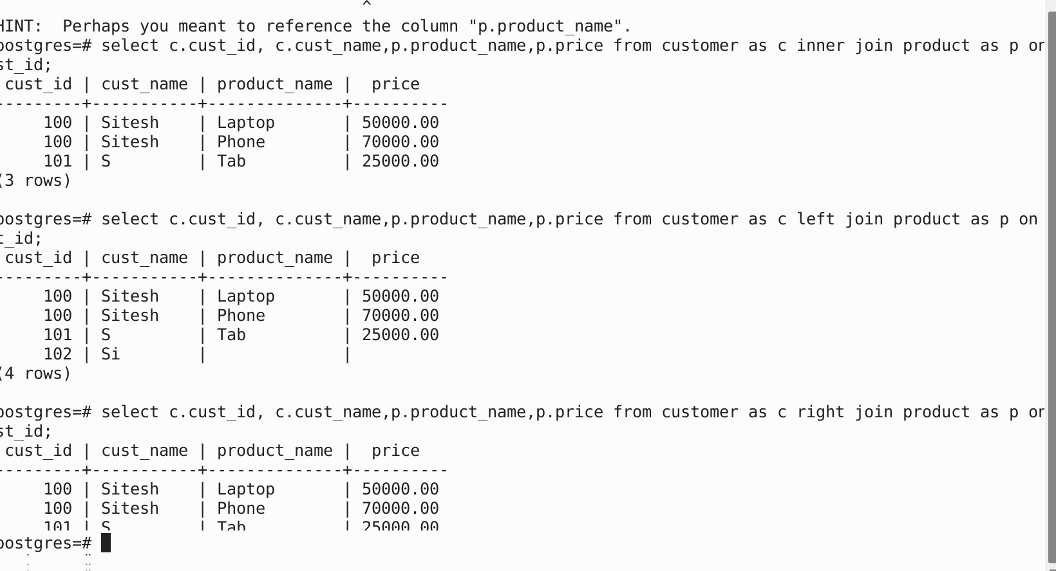

Slide 8
Day 4 ( Software Testing )
What is Software testing?
Learnt about STLC.
Phases of STLC.
Different types of testing.
Different types of testing such as unit testing, etc.

Slide 9
Learnt about the use of a tool called FitNesse to test an application. This tool was hosted in a remote desktop environment which was accessed by using remote desktop connection from our laptop.
Also learnt about different approaches about software testing such as TDD, ATDD, etc.

Slide 10
Day 5 ( Devops )
Learnt about Devops.
How different process help in deployment of application and the various stages involved in it.
Learnt about github.
Github actions
Various git commands.

Slide 11
Forked a repository in github
Performed various github actions on it.
Learned about .yml files.
Learnt about containerization and docker.
Did a little hands-on with github actions and build of apps

Slide 12
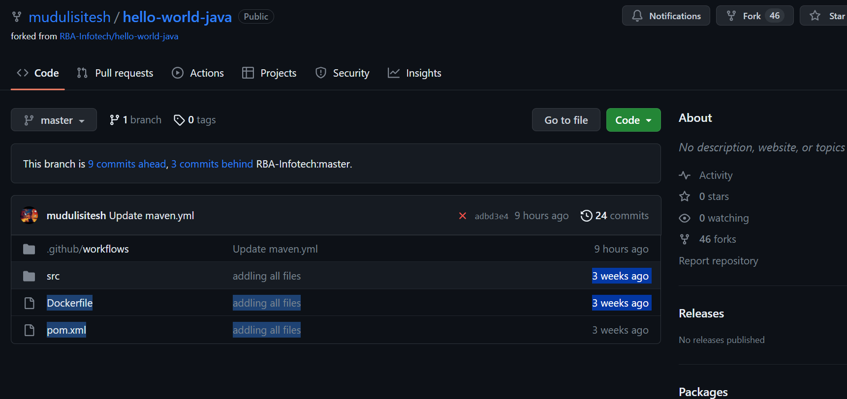

Slide 13
Day 6(Docker)
Used the github actions to commit changes to .yml file for docker and build and image for the app with all the dependencies.
Created a docker account to view and manage the state
Used azure cloud to create a VM for hosting the deployed app and running it in a port.

Slide 14
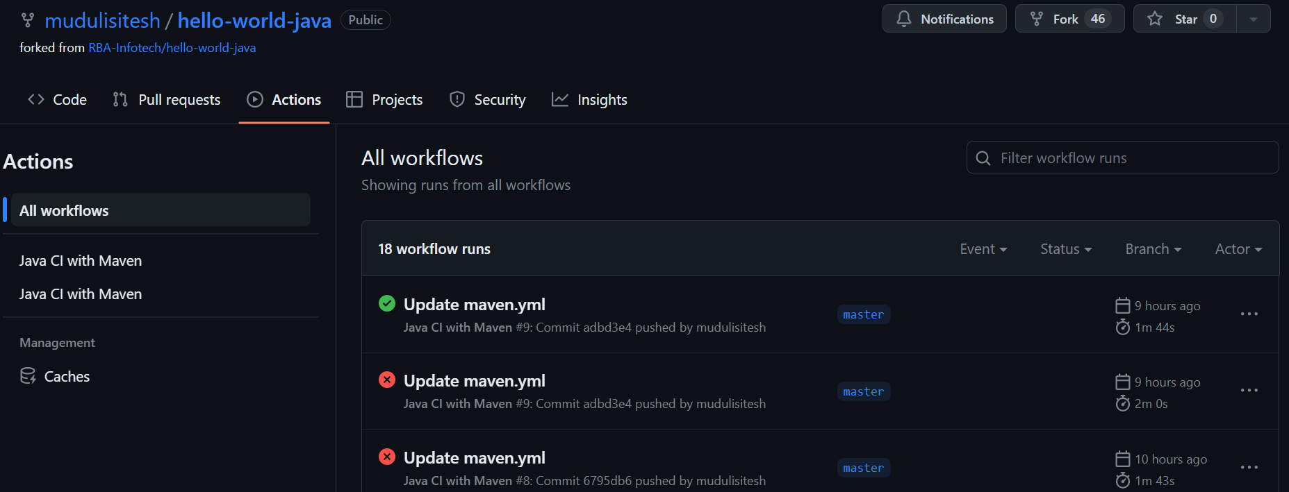

Slide 15
Day 7(Case work)
In this day we did all the things that was done in the previous day as a form of a case study we had to commit changes in github and build and deploy the build in a remote machine a VM using the credentials given to us.

Slide 16
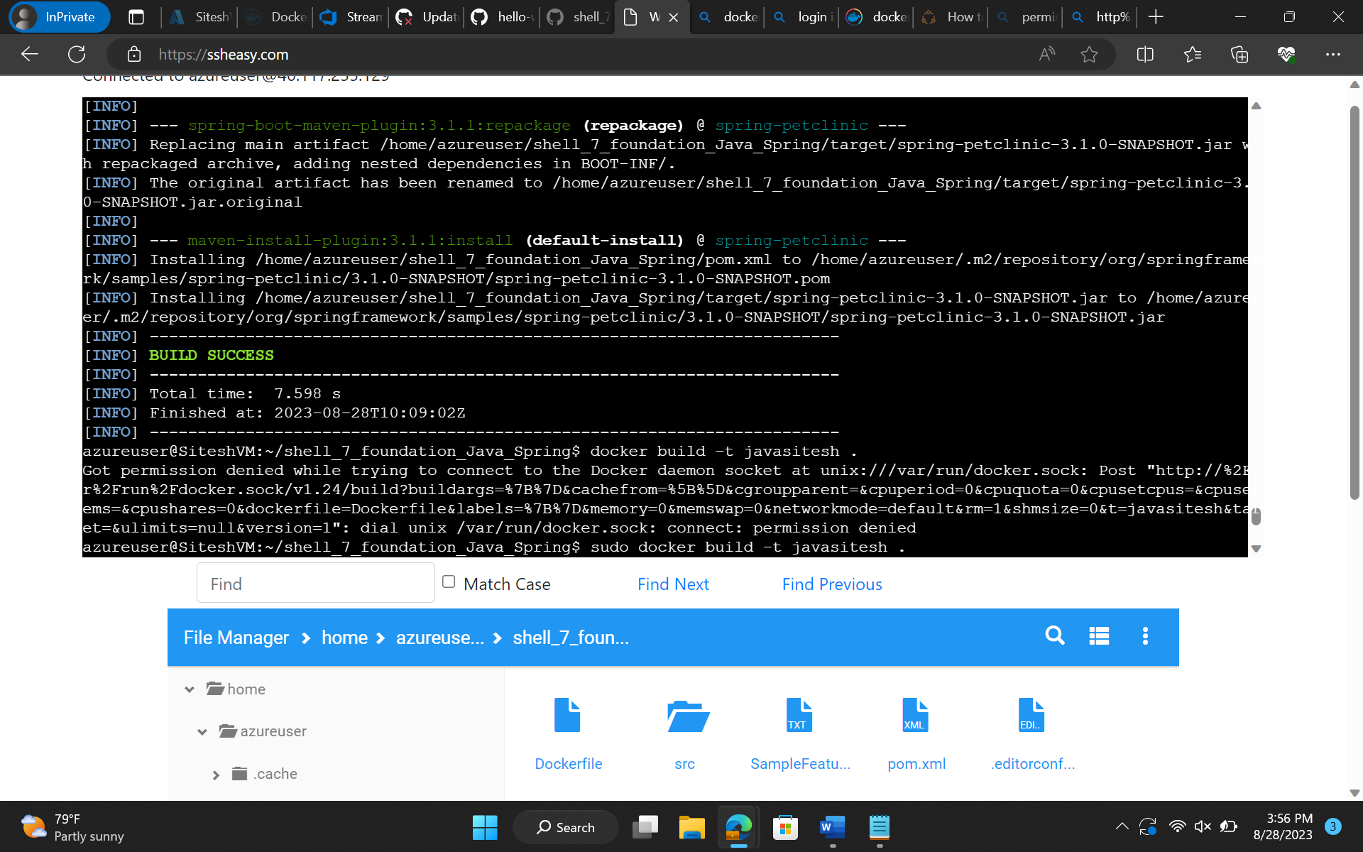

Slide 17
Custom Bootcamp (Day 1)
Learnt about the fundamentals of data
Data warehousing
Different types of SQL
Different types of NoSQL Data Base.
Deployed a VM using the sandbox

Slide 18
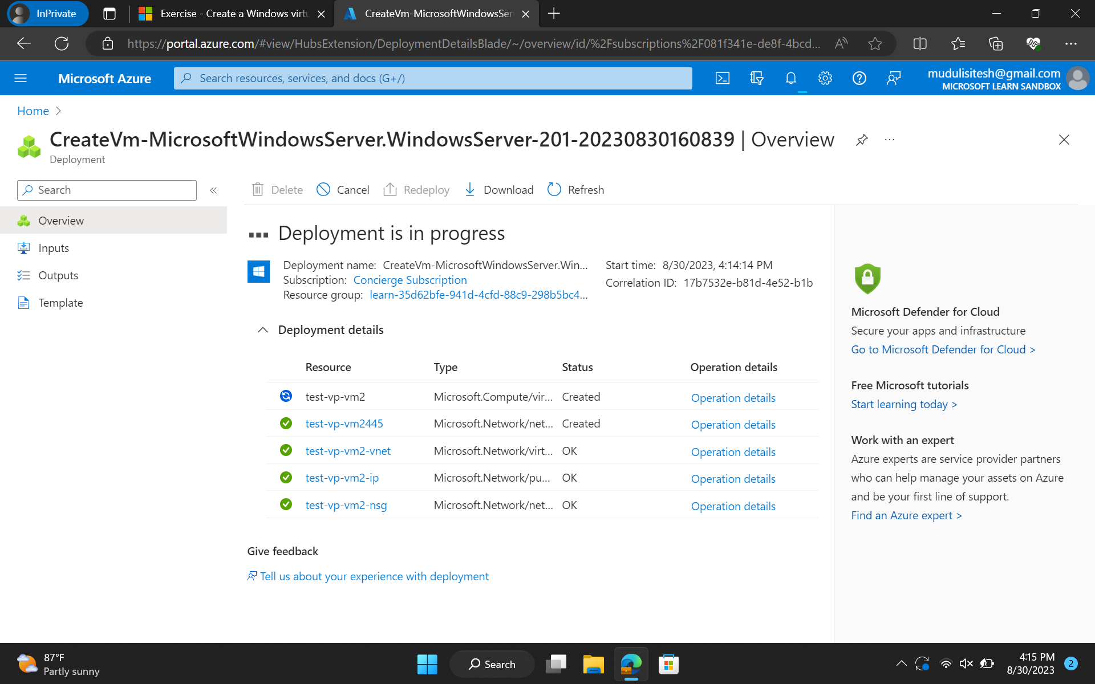

Slide 19
Custom Boot Camp (Day 2)
Learnt about Data Lakehouse
-Big Data
-Created a database schema for a given example problem/situation
-learned about various data pipelines and how a data is ingested in a system/company

Slide 20
Custom Bootcamp (Day 3)
Ran Different Queries and SQL Commands, on sample data sets, In Azure SQL. Additionally we learnt how to set up Azure SQL and how to authenticate the data base for the same.

Slide 21
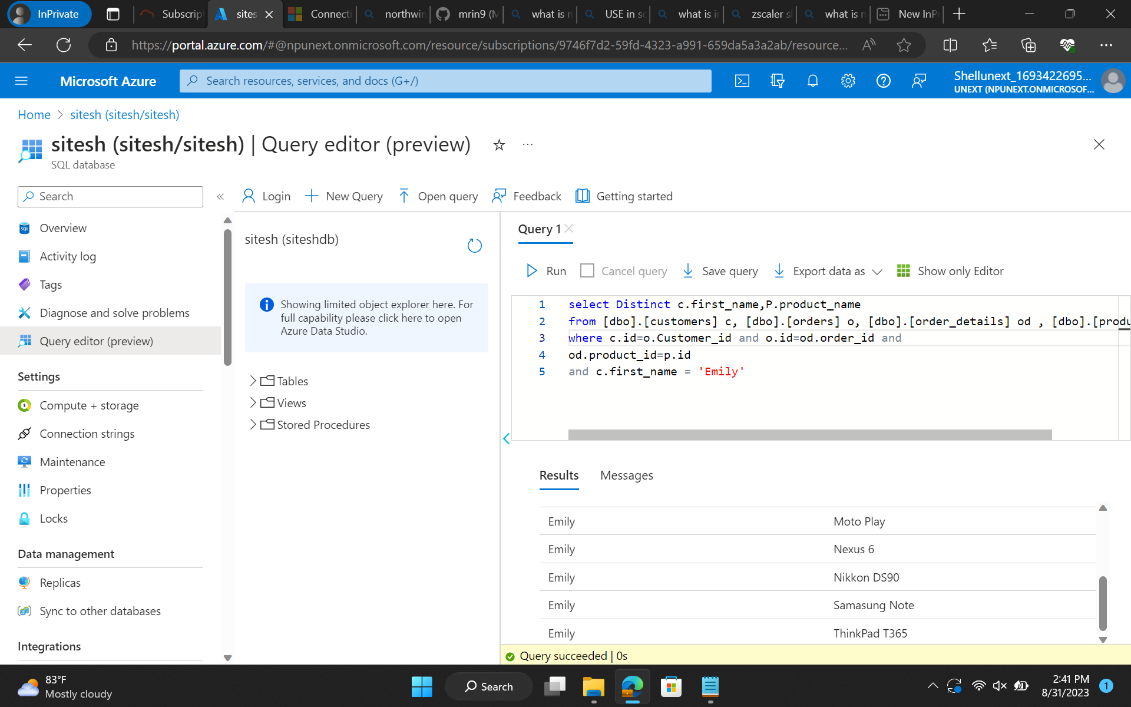

Slide 22
Custom Boot Camp Day 4
Learn About how to use sub queries for different types of result in Azure SQL.
Used Joins Also.

Slide 23
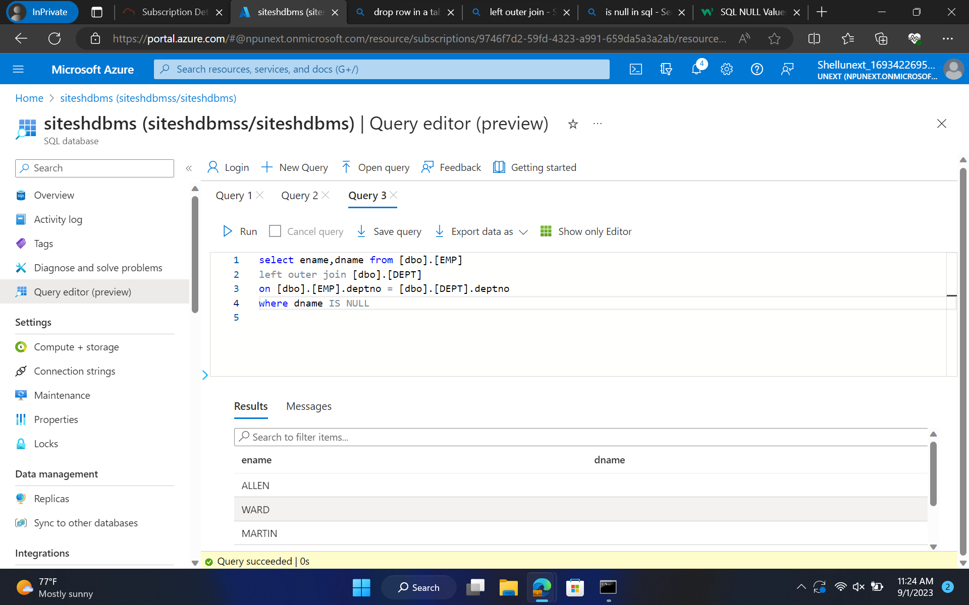

Slide 24
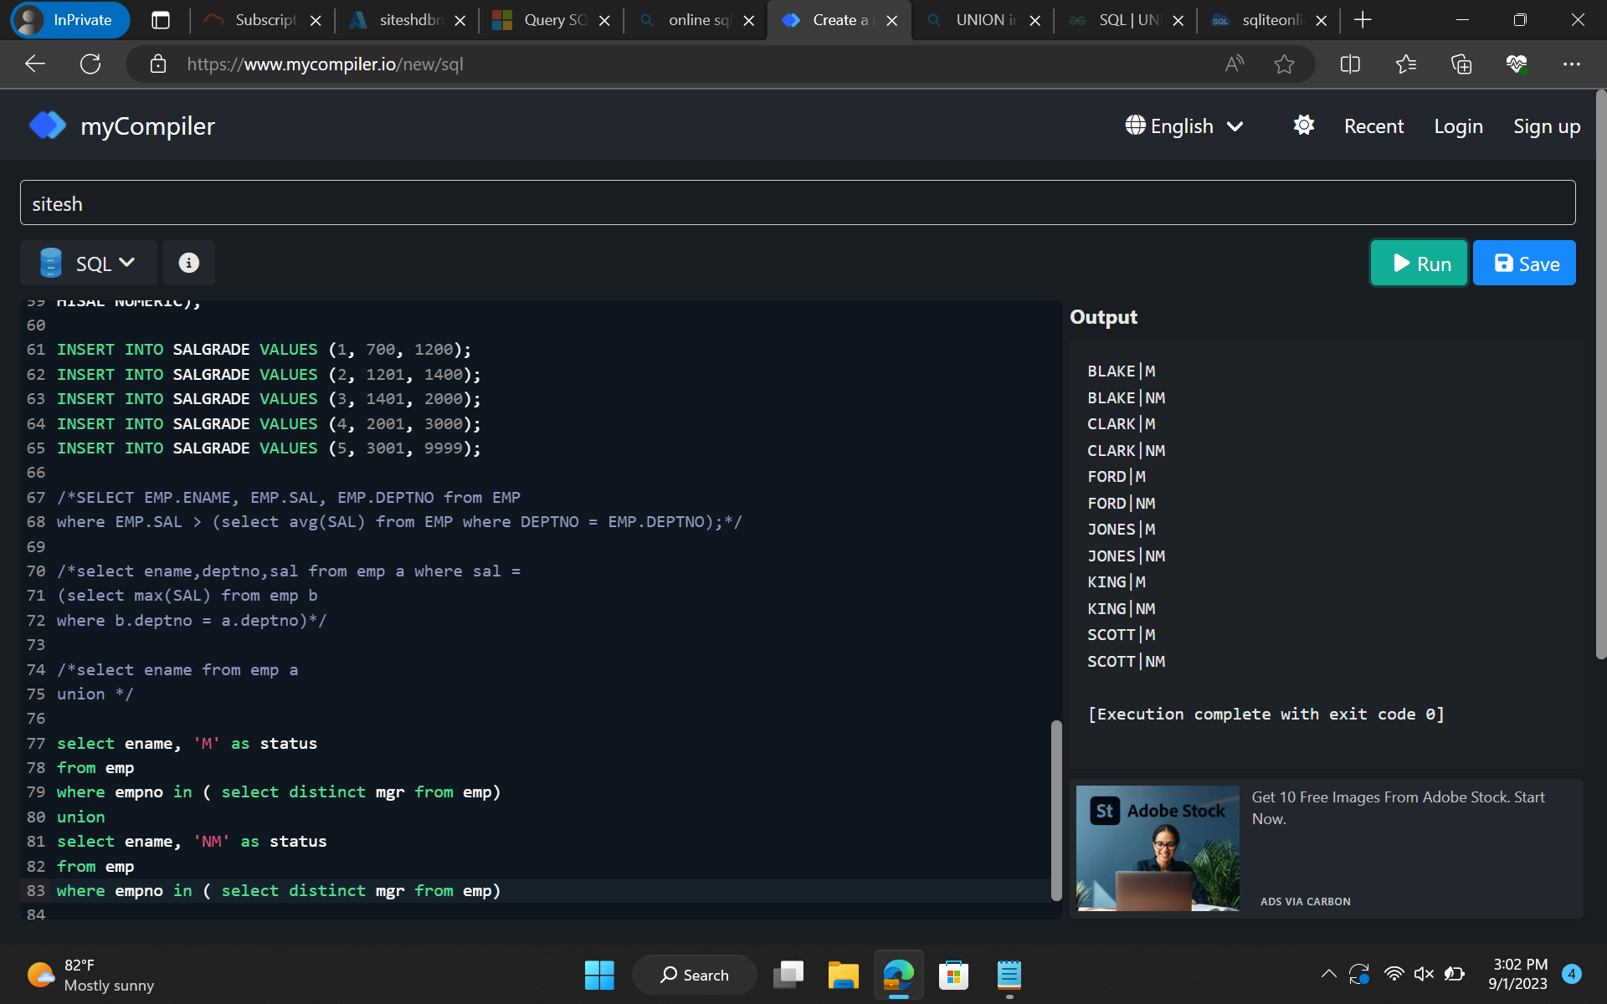

Slide 25
Day 5
Learnt about azure storage.
Blob storages
Data Lake Storages
File share
Queues
Concepts and uses behind it mainly

Slide 26
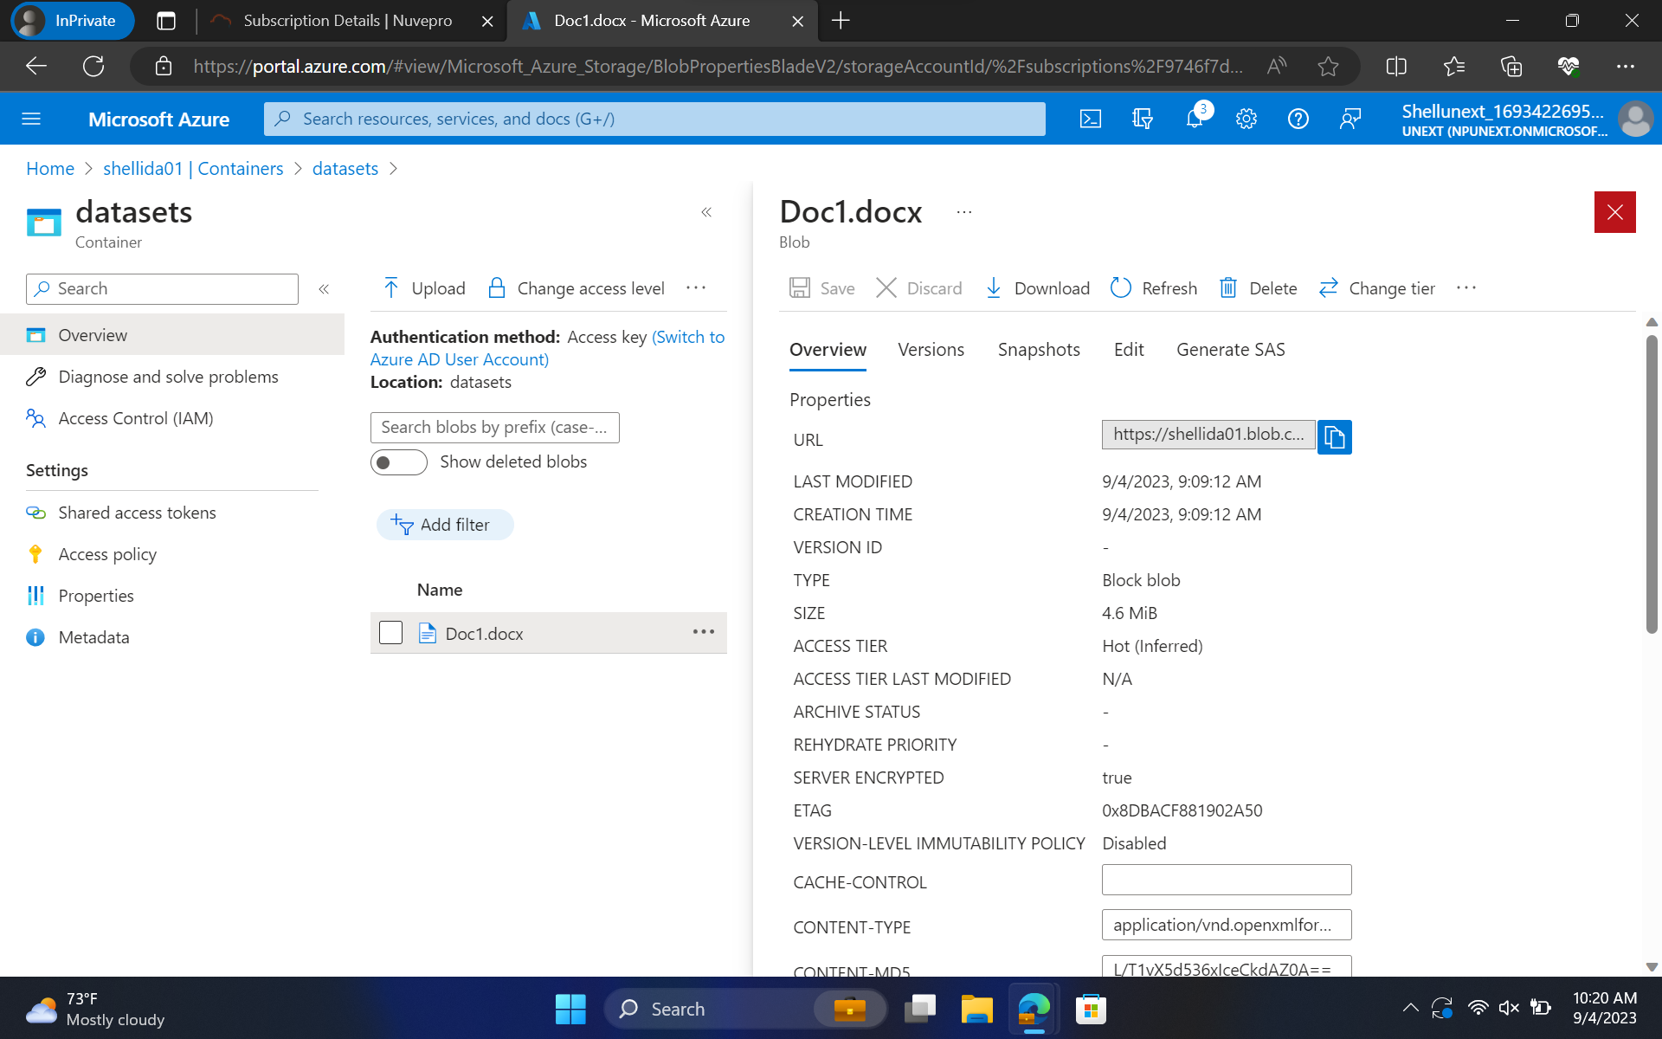

Slide 27
Day 6
Shared Access Storages
Properties of accessing the storage for a data flow
Intro to ADF
ETL Concepts
Pipeline
Orchestration, etc

Slide 28
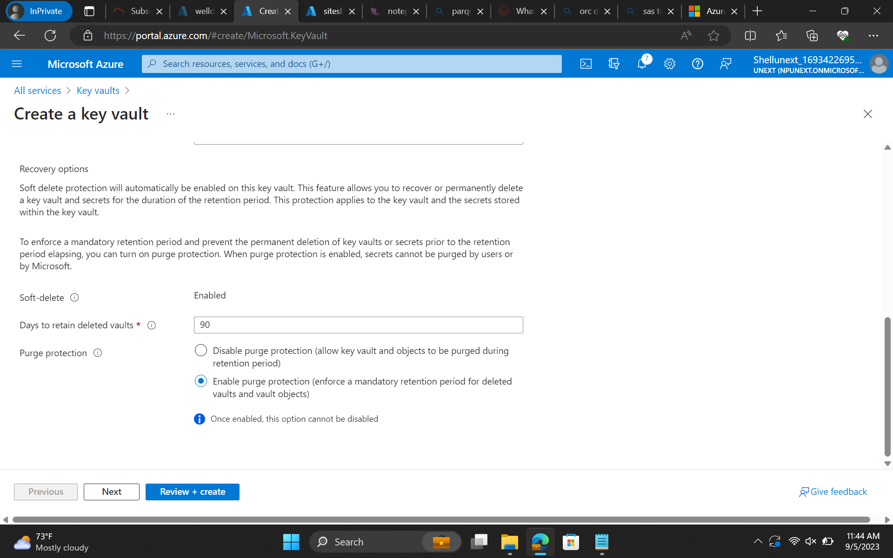

Slide 29
Day 7
ADF Components Hands-on such as
Copy data flow
Metadata activity
Filter activity
Pipelines
etc

Slide 30
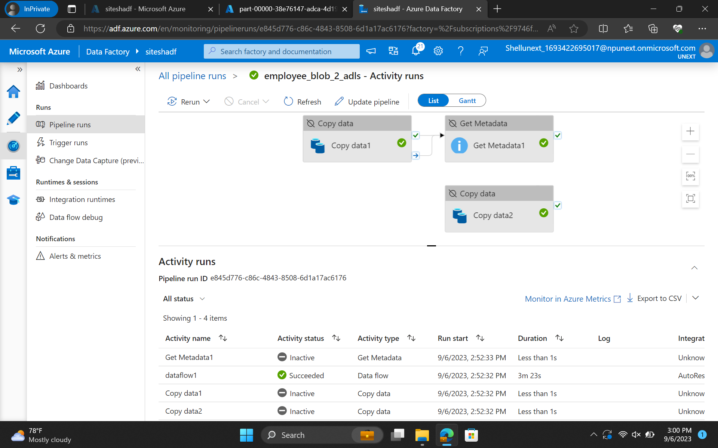

Slide 31
Day 8
Learnt about mapping
Transformation
Conditional split
API calling
REST API’s
Data flow diagrams

Slide 32
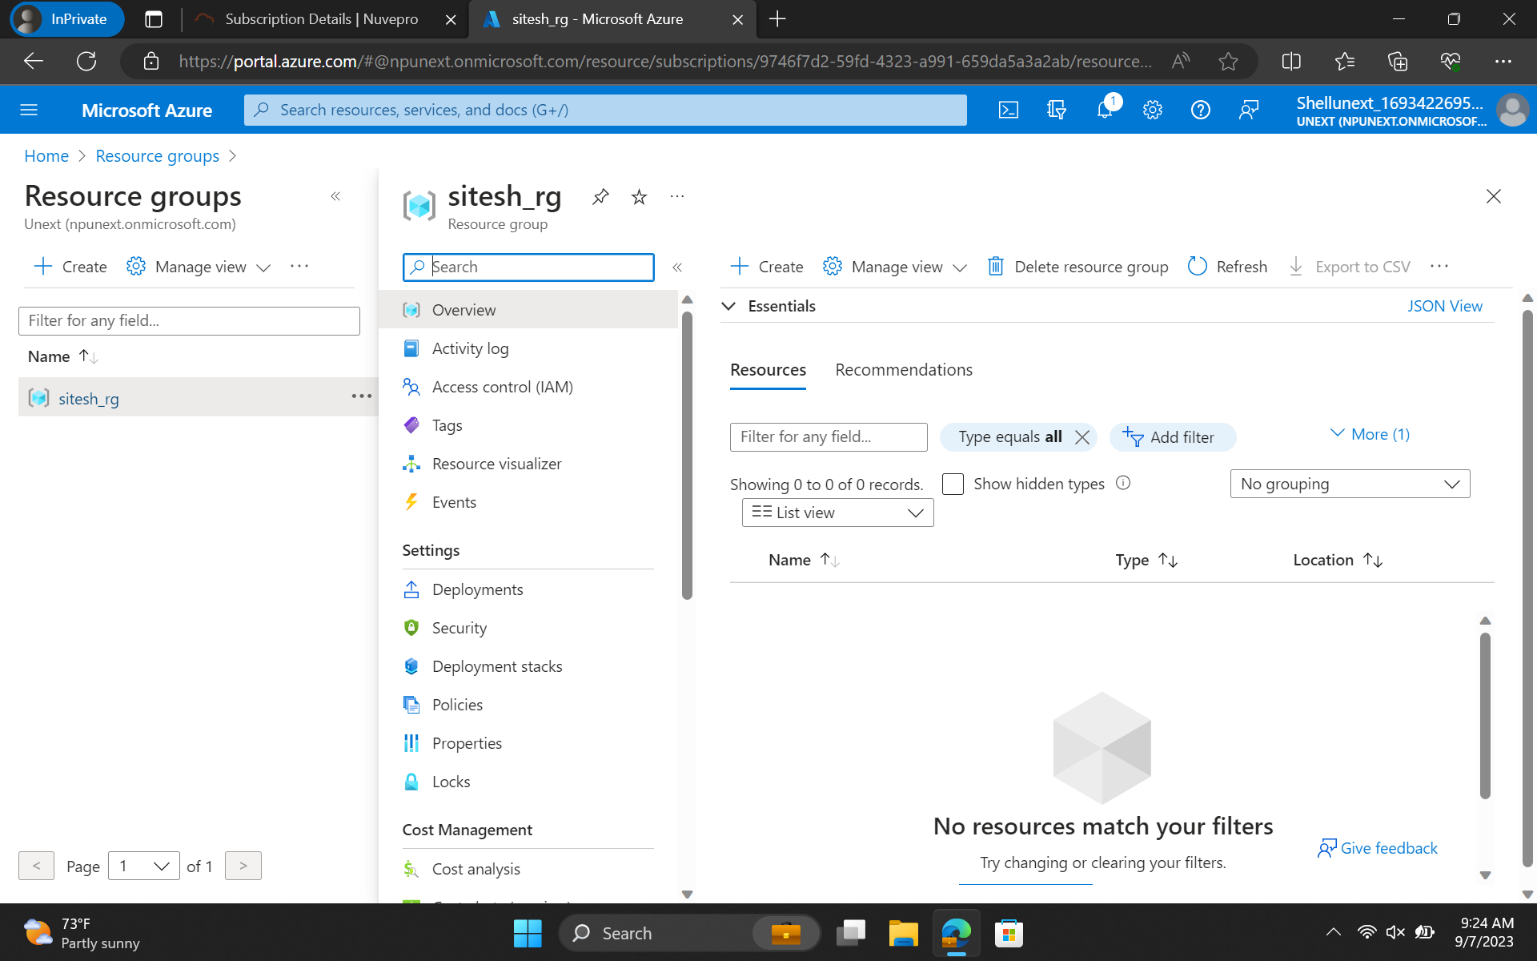

Slide 33
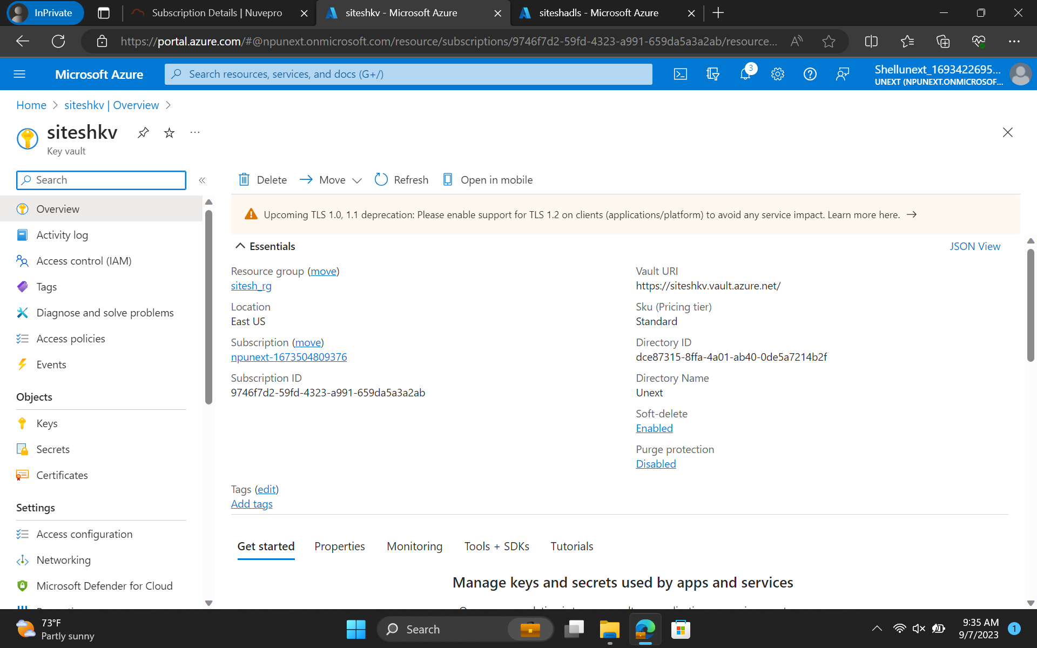

Slide 34
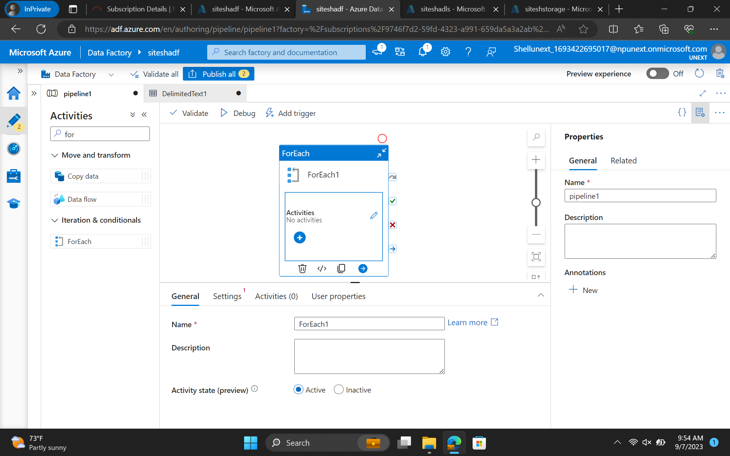

Slide 35
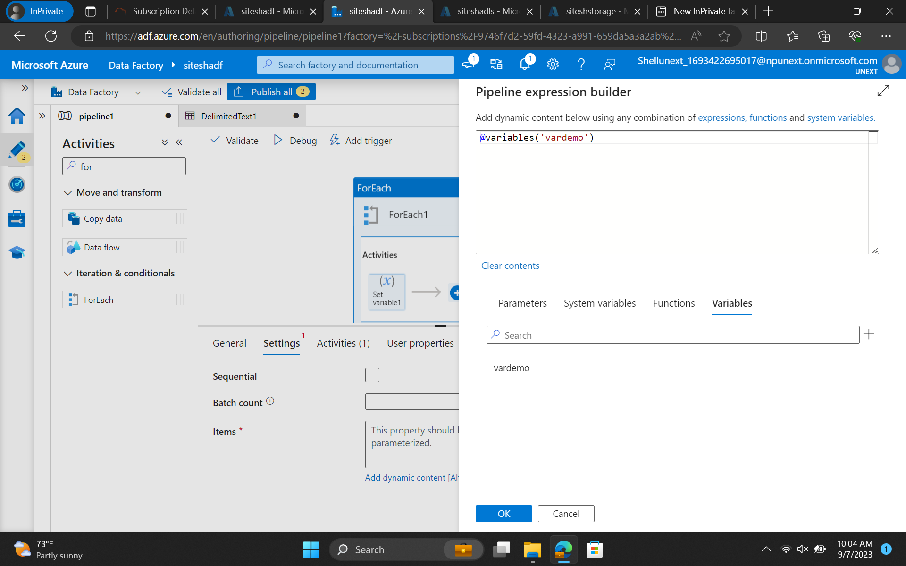

Slide 36
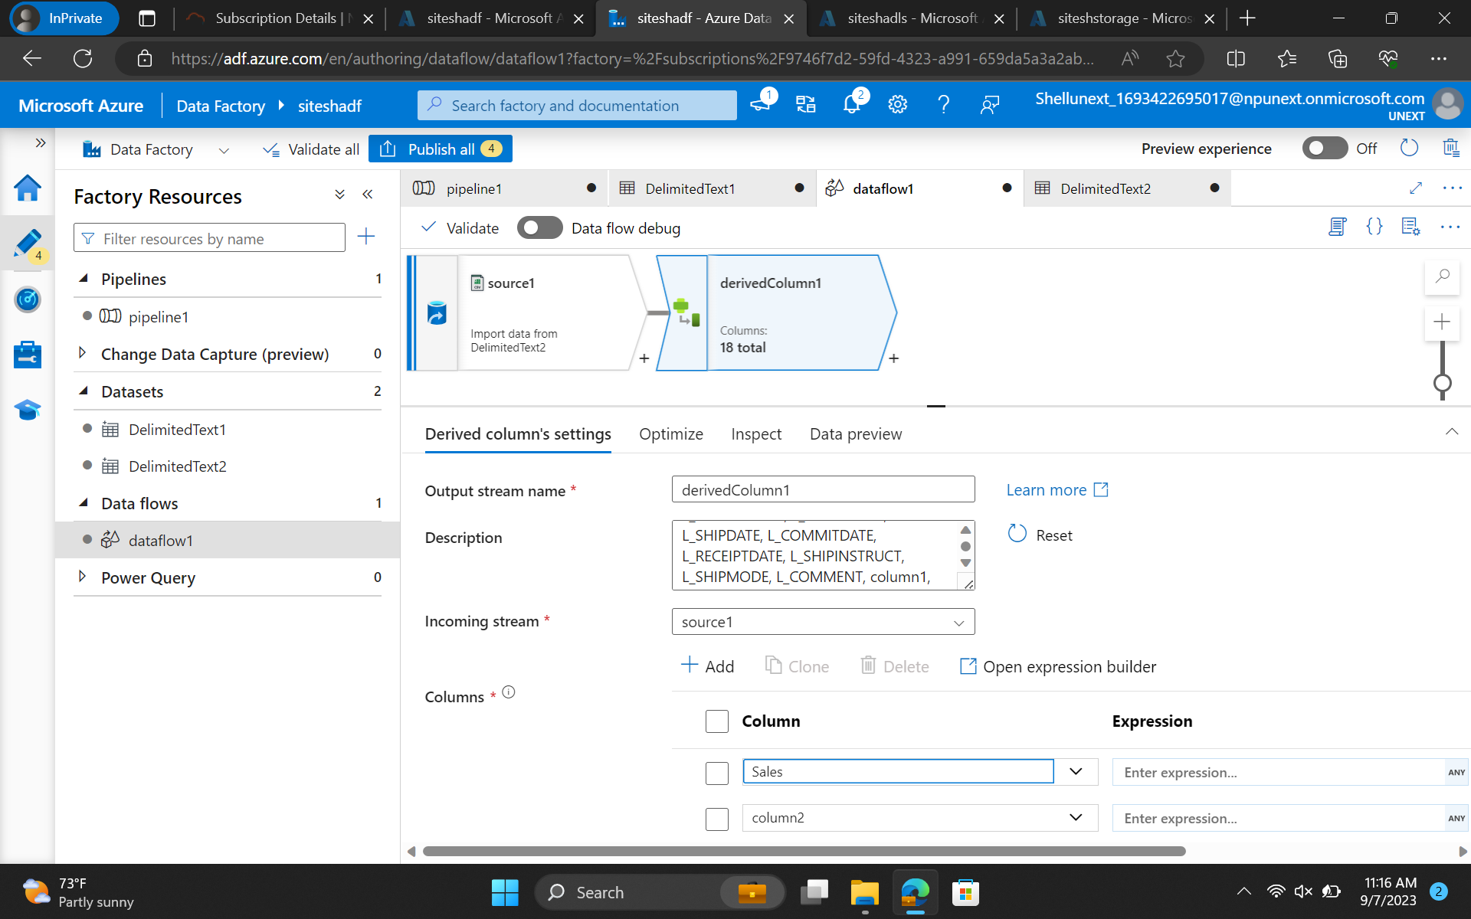

Slide 37
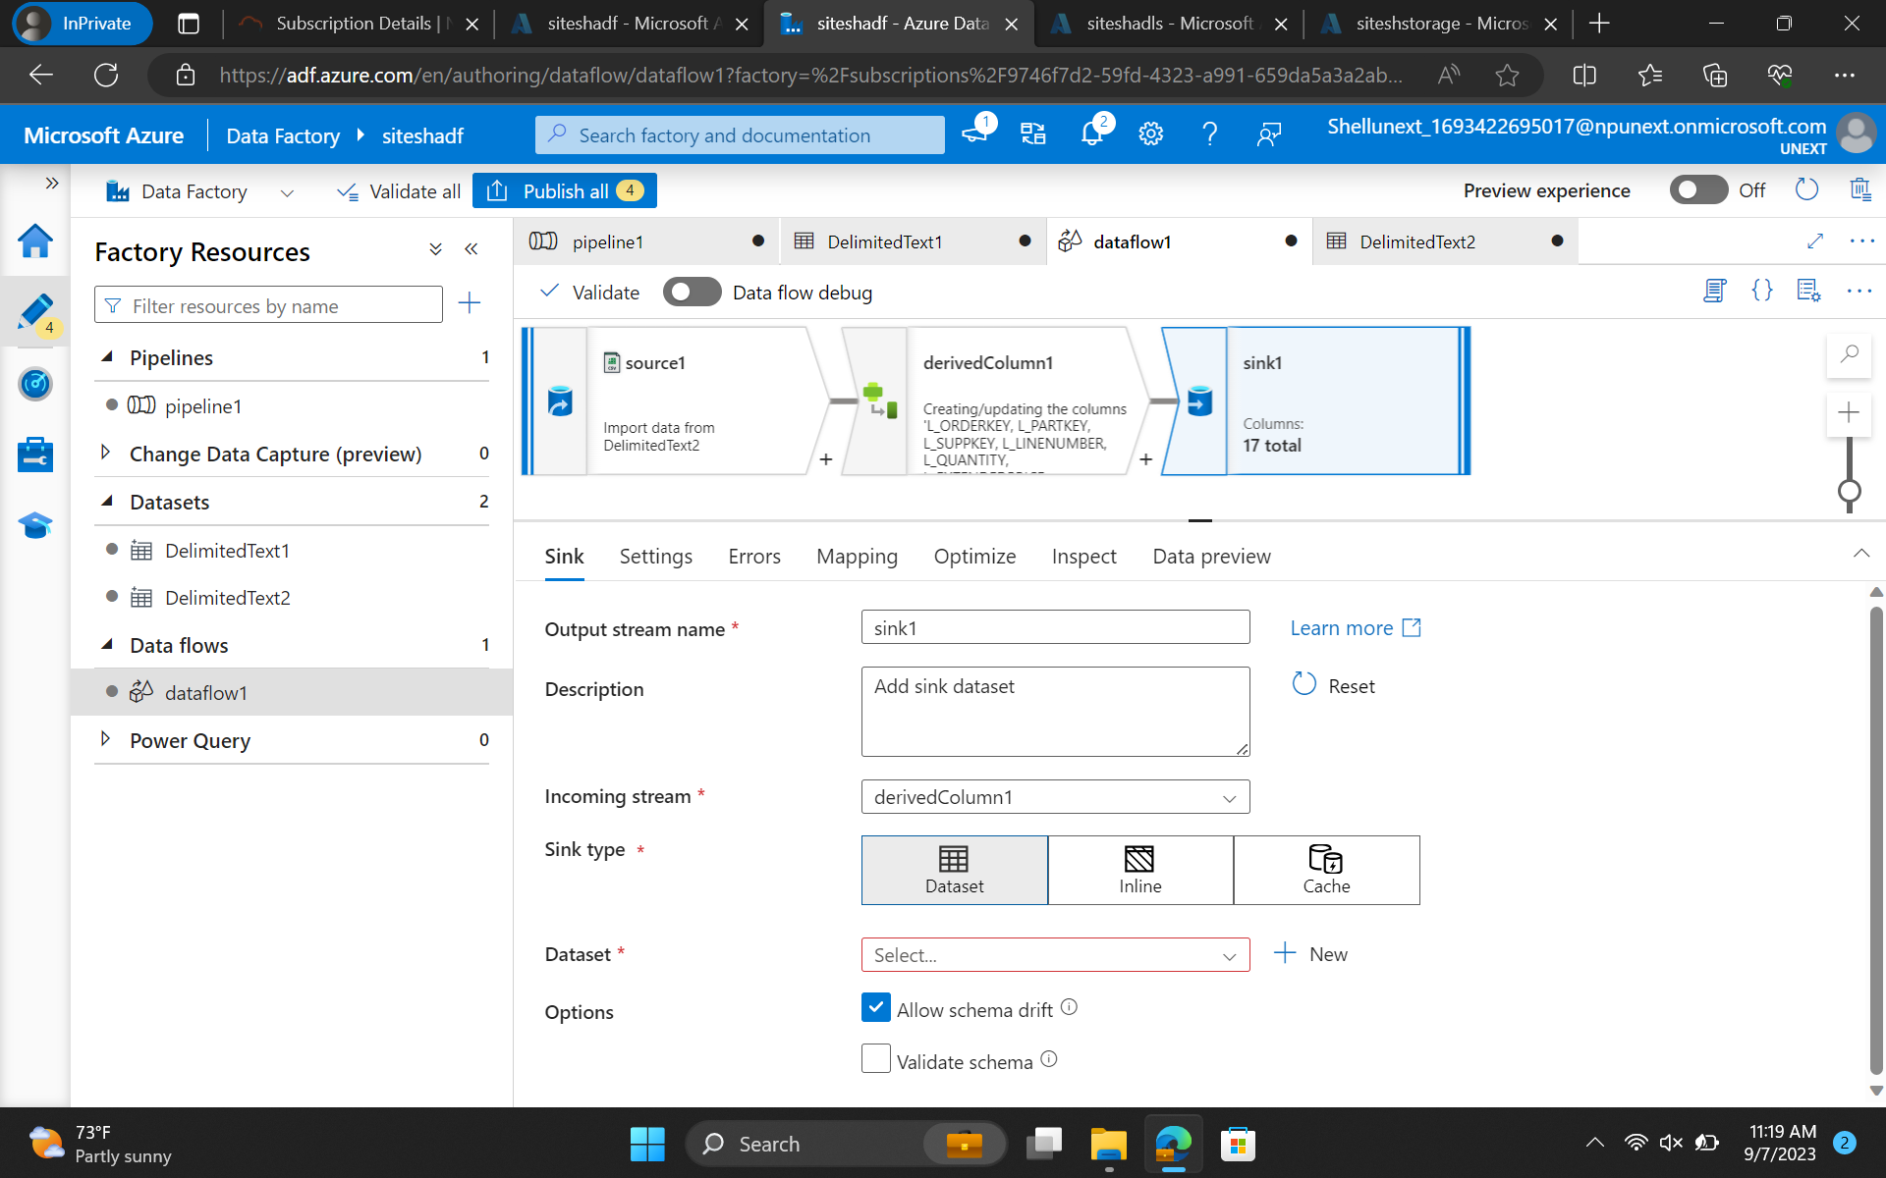

Slide 38
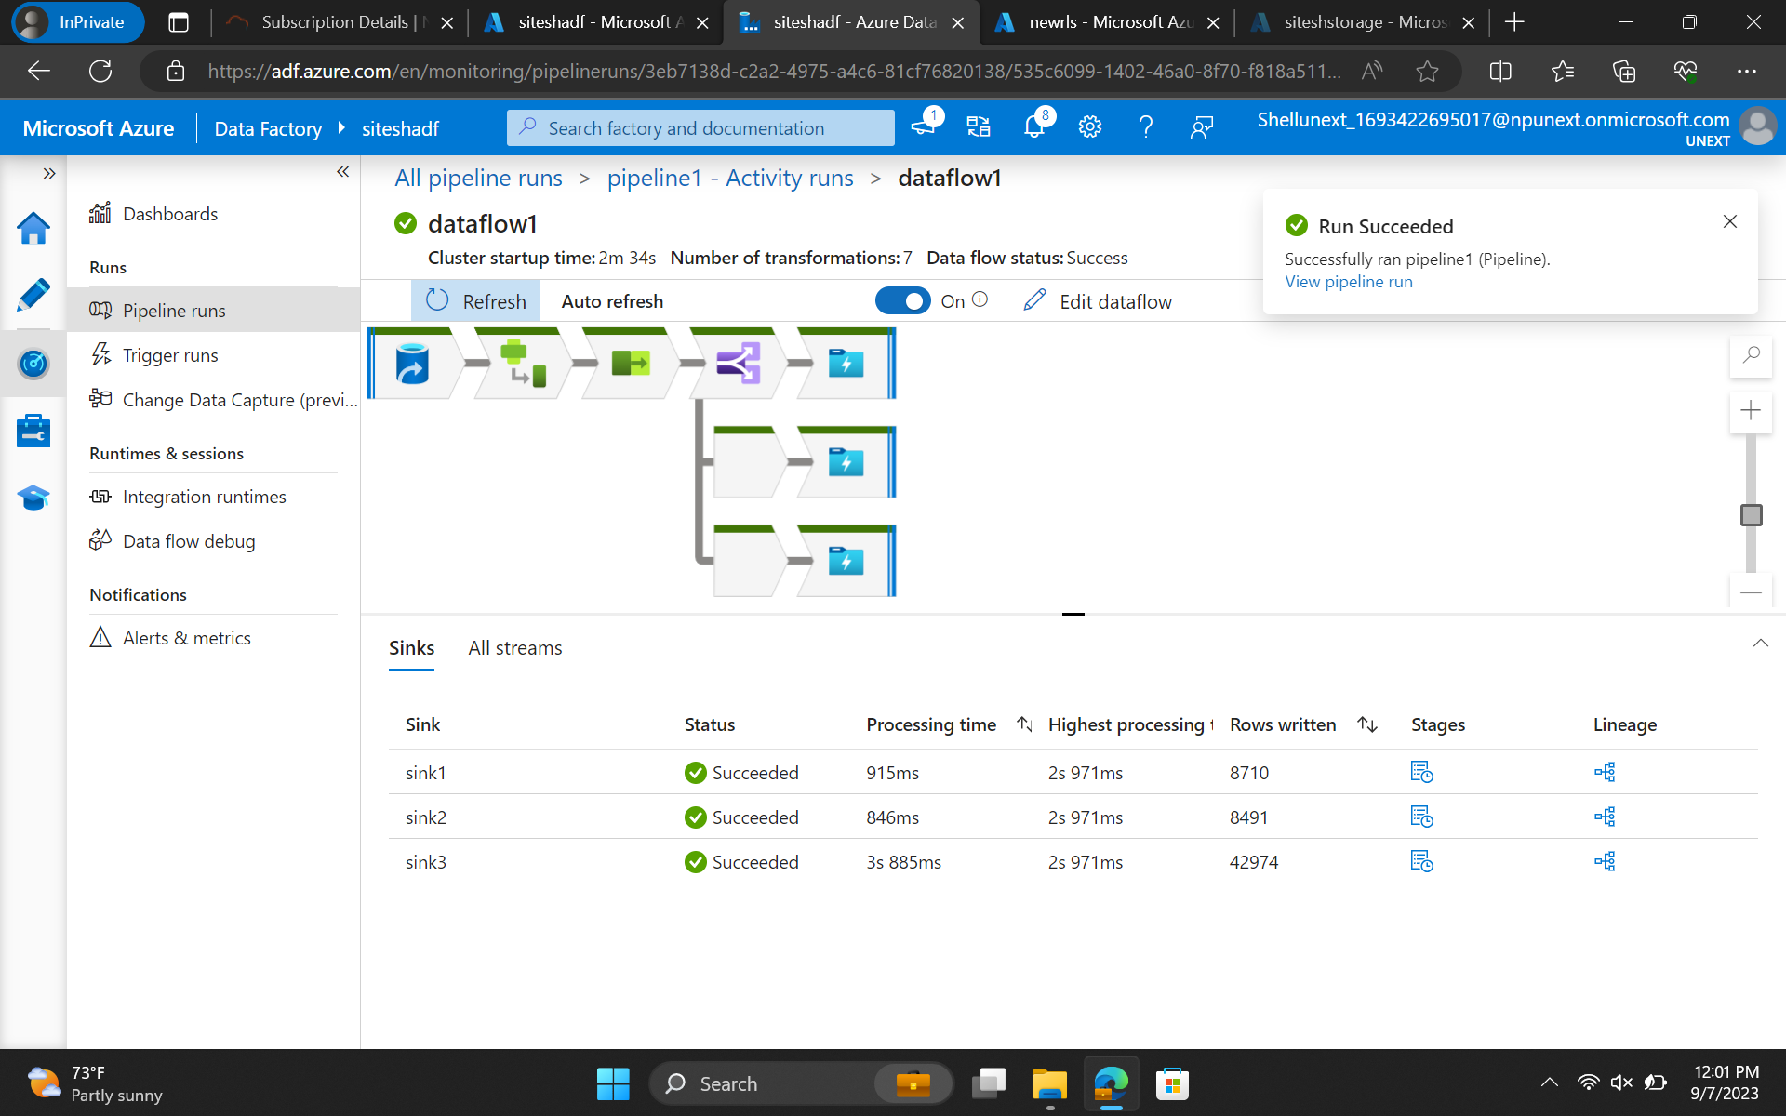

Slide 39
Day 9
CDC Implementation and architecture
Real-time data synchronization with the data base in a remote server
Troubleshooting techniques.
etc

Slide 40
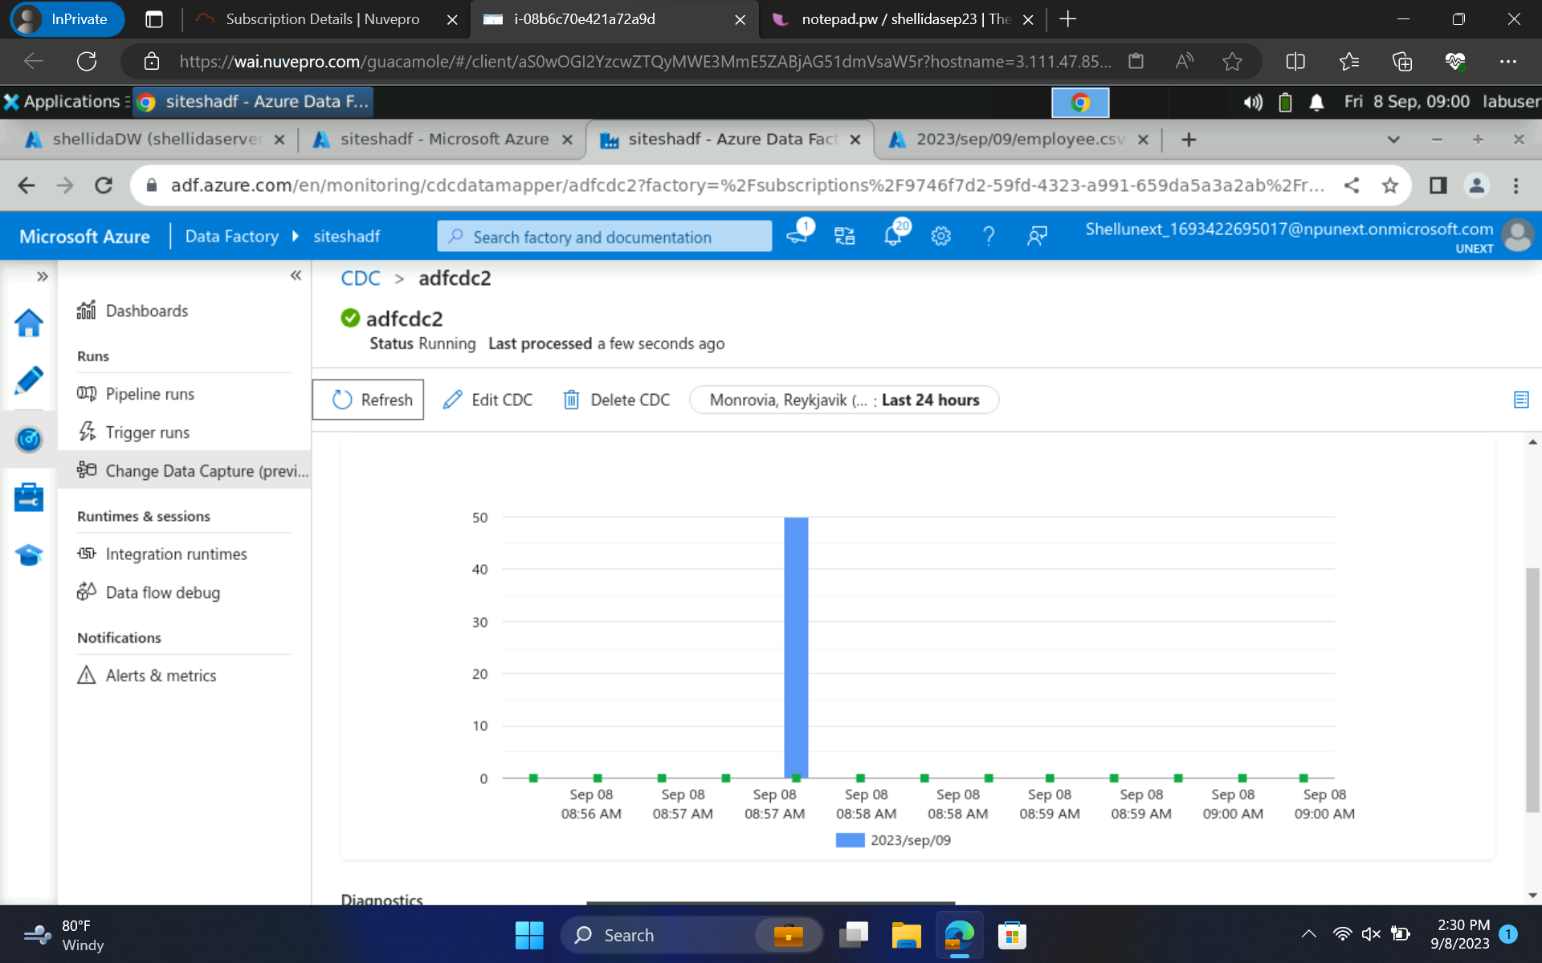

Slide 41
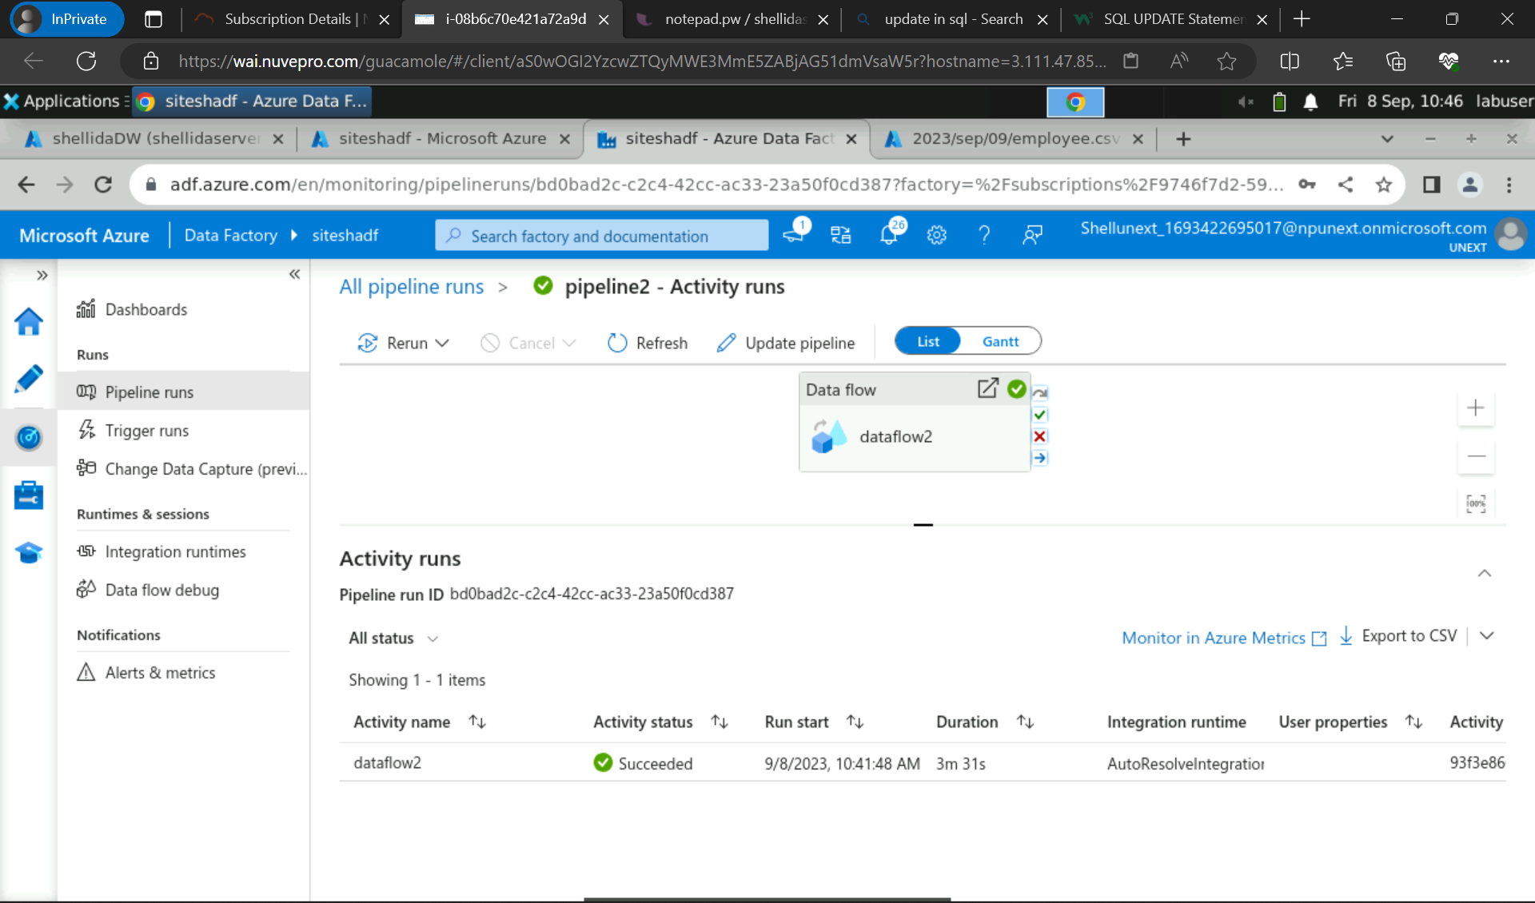

Slide 42
Day 10(Azure Synapse Analytics)
Used Azure Synapse- Pipelines(etc)
Monitored the pipeline
Mapped Azure Synapse Data Flow

Slide 43
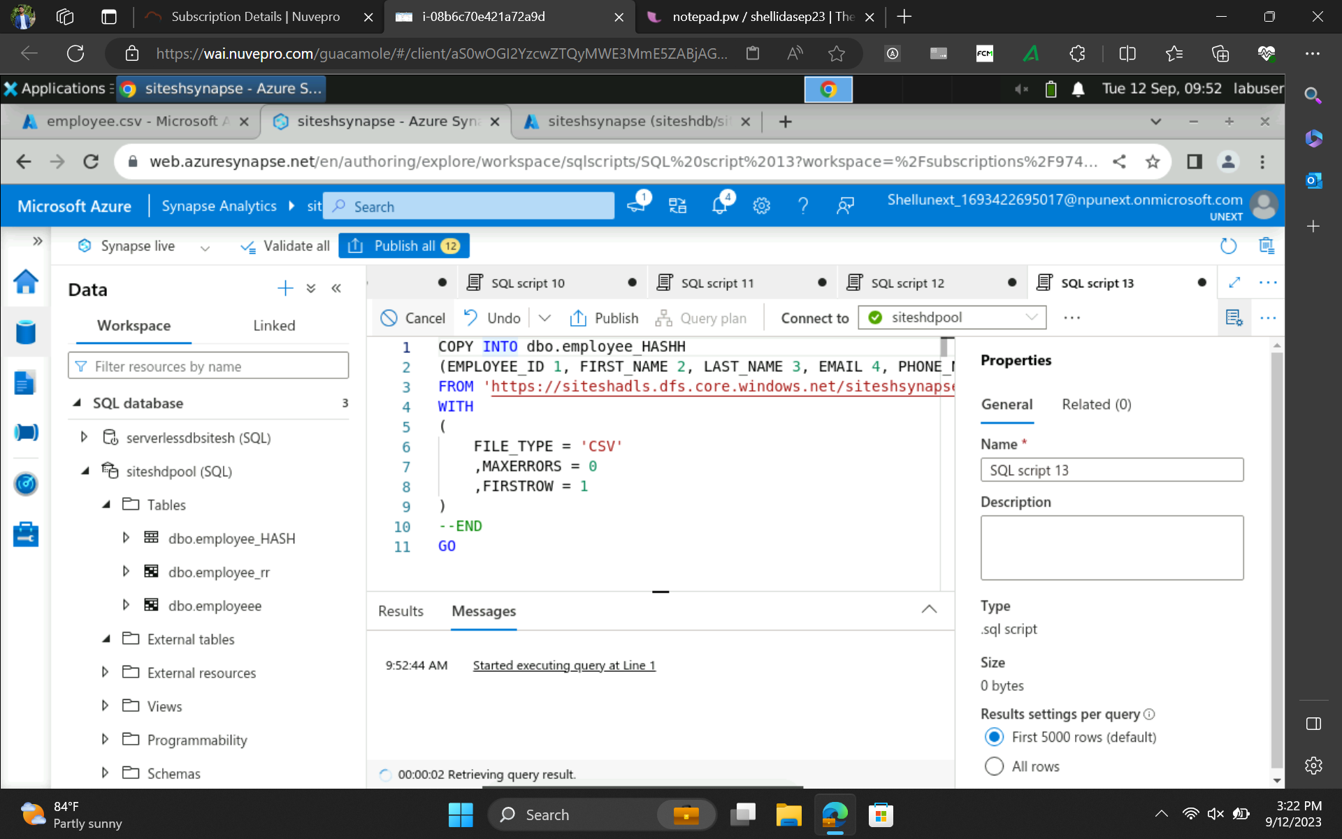

Slide 44
Day 11(Power Bi)
Ingesting Data
Handling Dates
Replacing Values
Aggregation Types etc
Slicing

Slide 45
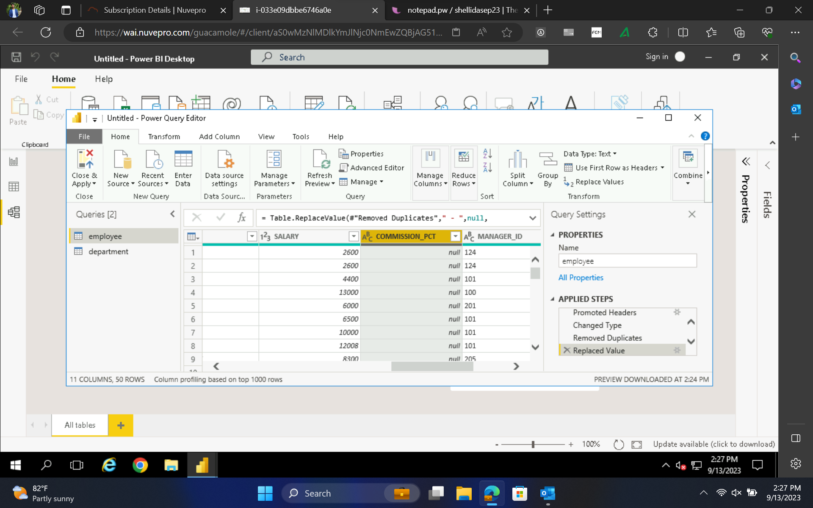

Slide 46
Day 12(Power Bi)
Understanding Various Charts
Reporting
Analysis

Slide 47
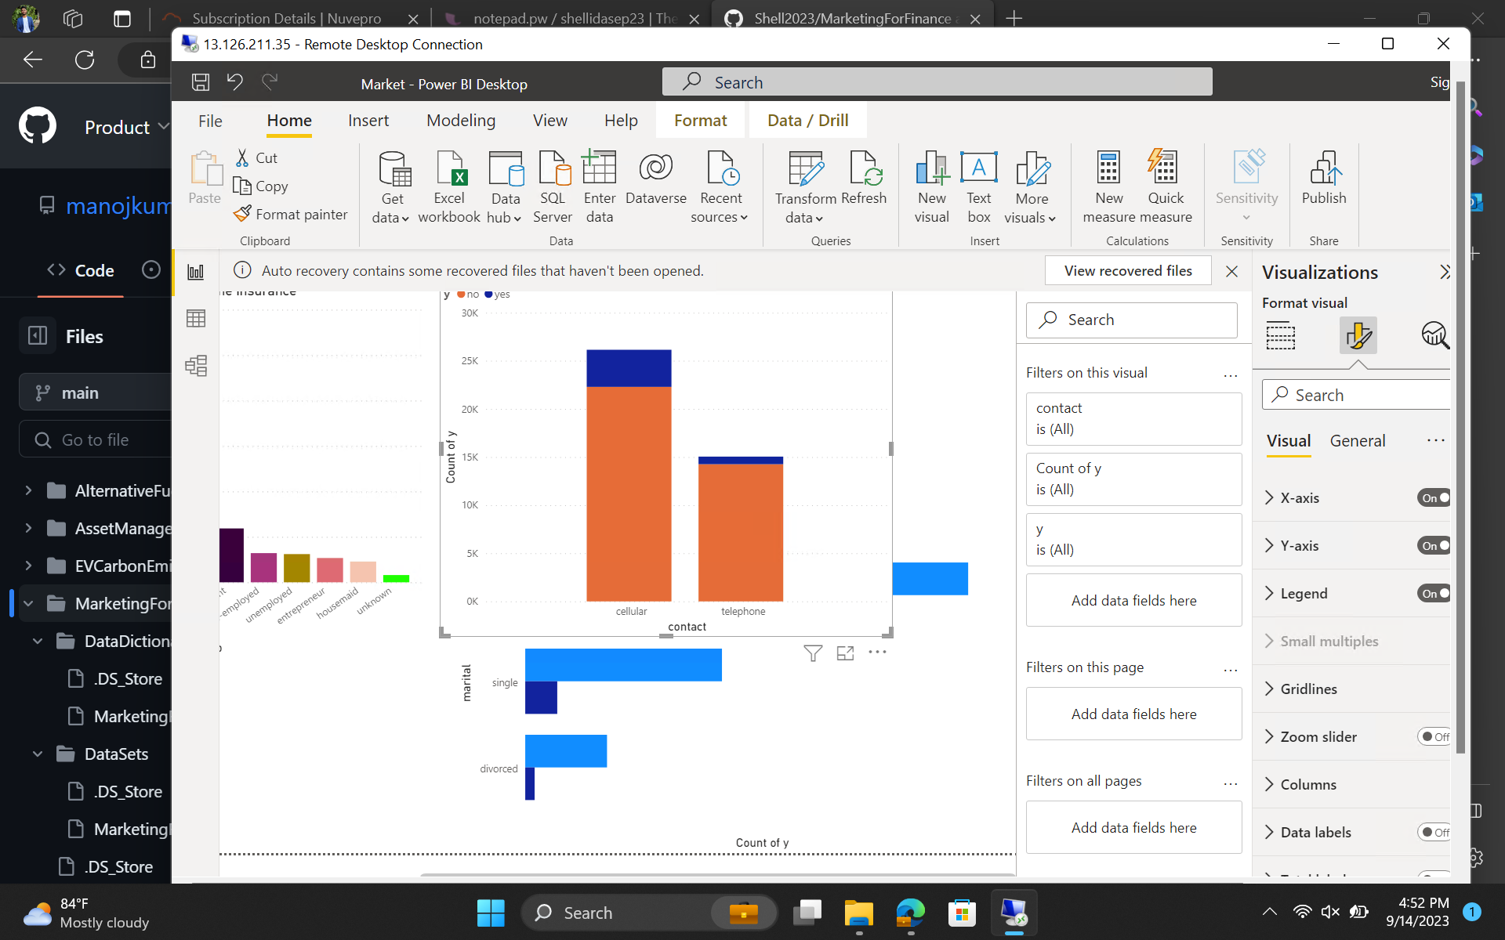

Slide 48
Day 13 (Python)
Python Data Types
Introduction
Enumerate functions
Zip Function
If-else
For loop
Jupyter Notebook

Slide 49
